Slide 1
Drop Vertical Jumps to Assess Risk for Knee Degeneration and Future Total Knee Arthroplasty
Group Members:
Eswar Kumar Katragadda
Juliana El Rayes
Vani Pailla
Mentor: Nathan Schilaty

Slide 2





OVERVIEW
01
04
Problem Statement
Demonstration
02
05
Motivation
Next Steps
03
06
Our Solution
Q&A

Slide 3
PROBLEM STATEMENT
In a study done by our mentor, Dr. Nathan Schilaty, EMG and 3D motion capture data were collected during drop vertical jumps to study knee biomechanics. Due to a failed trigger signal, the data aren’t synchronized.
Our focus is to align these datasets and create a synchronization method for EMG and motion capture data that enables accurate analysis of muscle and joint behavior during movement.
* EMG: Electromyography

Slide 4
MOTIVATION
Understanding Knee Degeneration
Need for Accurate Data Alignment
How does aging affects muscle control and knee function?
Accurate sync between EMG and motion data is key for analysis.
Early Detection
Deeper Analysis
Finding early signs of knee degeneration may help prevent surgeries like TKA.
Our alignment work could enable meaningful comparisons of muscle and joint behavior.
* TKA: Total Knee Arthroplasty

Slide 5
TYPES OF JUMPS IN THE STUDY
DVJ
LSLL
RSLL
CMJ
Drop Vertical Jump
Left Single-Leg Landing
Right Single-Leg Landing
Countermovement Jump

Slide 6
OUR SOLUTION
Original Data
EMG .hpf and 3D motion .tak files were converted to .csv for processing.
UTC Extraction
Python script pulled start times from EMG .hpf files for synchronization.
Batch EMG Plotting
MATLAB script generated PNG plots of EMG signals for quick visual review.
Final Alignment
Python script matched EMG and motion data and split them into aligned jump trials.
Live EMG Inspection
MATLAB script allowed zoomed-in viewing to spot alignment features.

Slide 7
OUR SOLUTION
MATLAB Batch Plotting Script
We were given EMG data as .csv files with varying column formats.
Script reads each file, finds the correct left and right Vastus Lateralis signals, and extracts them.
Generates side-by-side plots for left and right muscles.
Saves each plot as a high-resolution .png for visual inspection and pattern detection.

Slide 8
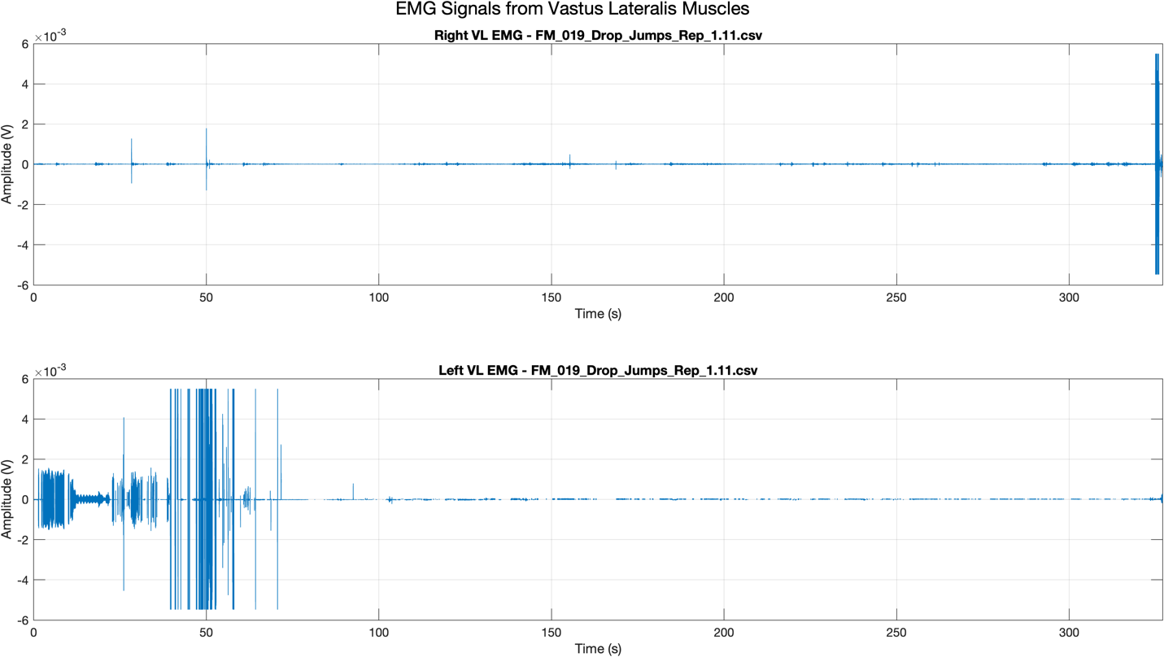
DEMOSTRATION
MATLAB Batch Plotting Script

Slide 9
OUR SOLUTION
MATLAB Live Script for Visual Inspection
Allow us to interactively select and inspect individual EMG .csv files.
Plots full-duration signals for both left and right Vastus Lateralis muscles.
Also generates zoomed-in views of a specific time window.
Helps identify bursts, spikes, and other features for alignment.

Slide 10
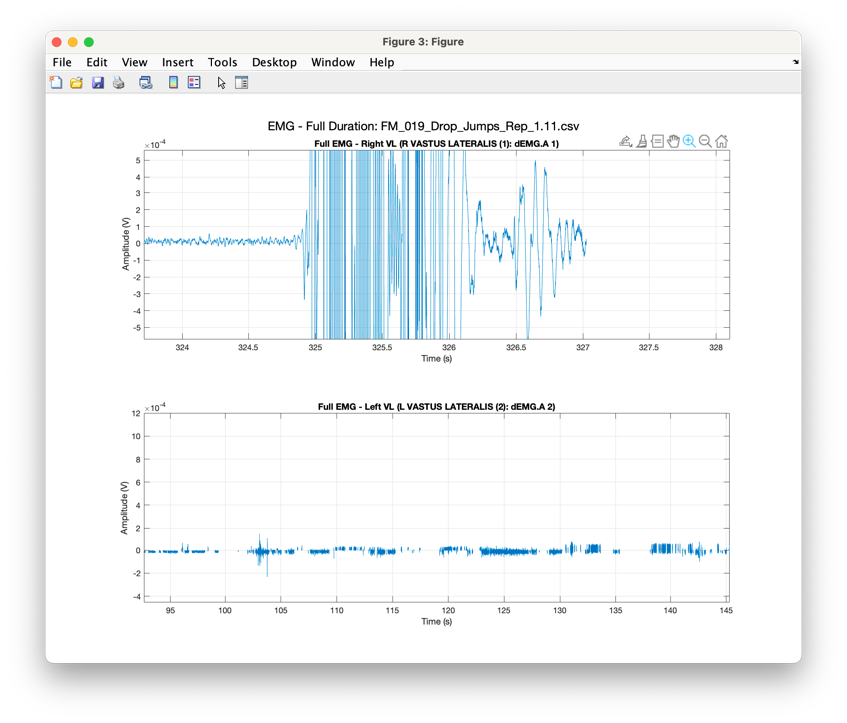
DEMOSTRATION
MATLAB Live Script for Visual Inspection

Slide 11
OUR SOLUTION
Python Script for UTC Timestamps
Processes a folder of .hpf EMG files to extract UTC start times.
Uses regular expressions to find <StartTime> tags in file metadata.
Stores each filename and its timestamp in a summary .csv.
The timestamps support time-based alignment with motion capture data.

Slide 12
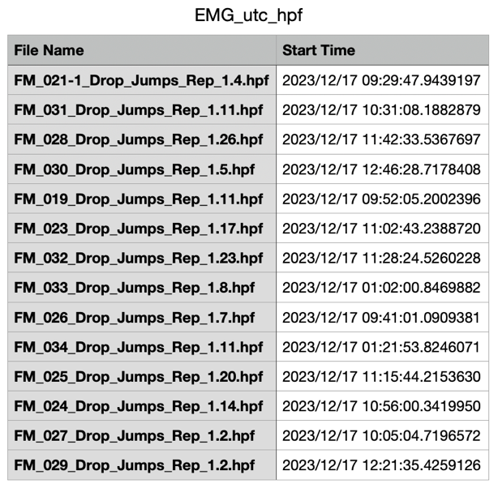
DEMOSTRATION
Python Script for UTC Timestamps

Slide 13
OUR SOLUTION
Python Script for Final Alignment
Uses extracted UTC start times from both EMG files and 3D motion capture .csv files.
Matches each EMG recording with the correct motion file based on timing.
Splits the motion data into individual jumps to align with EMG bursts.

Slide 14
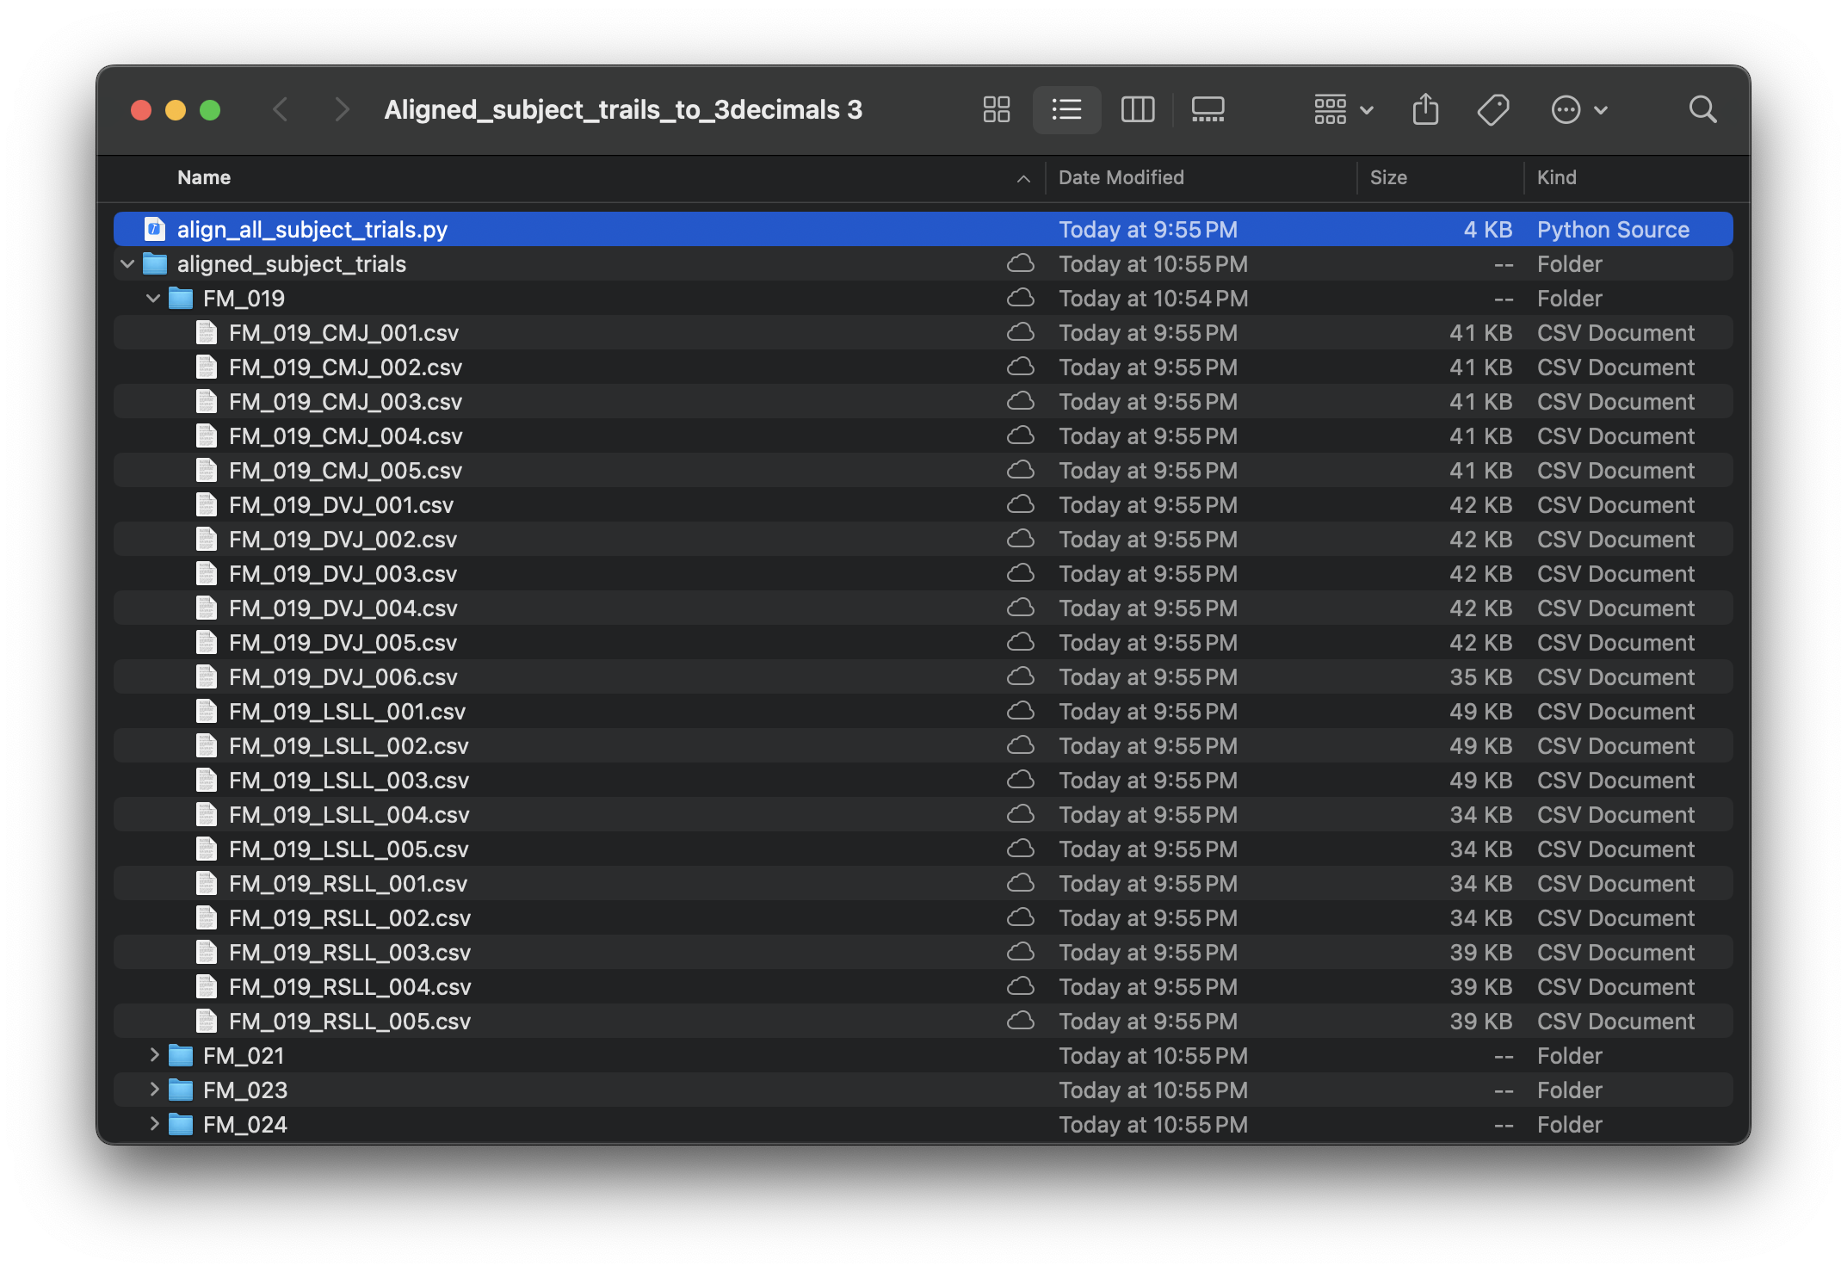
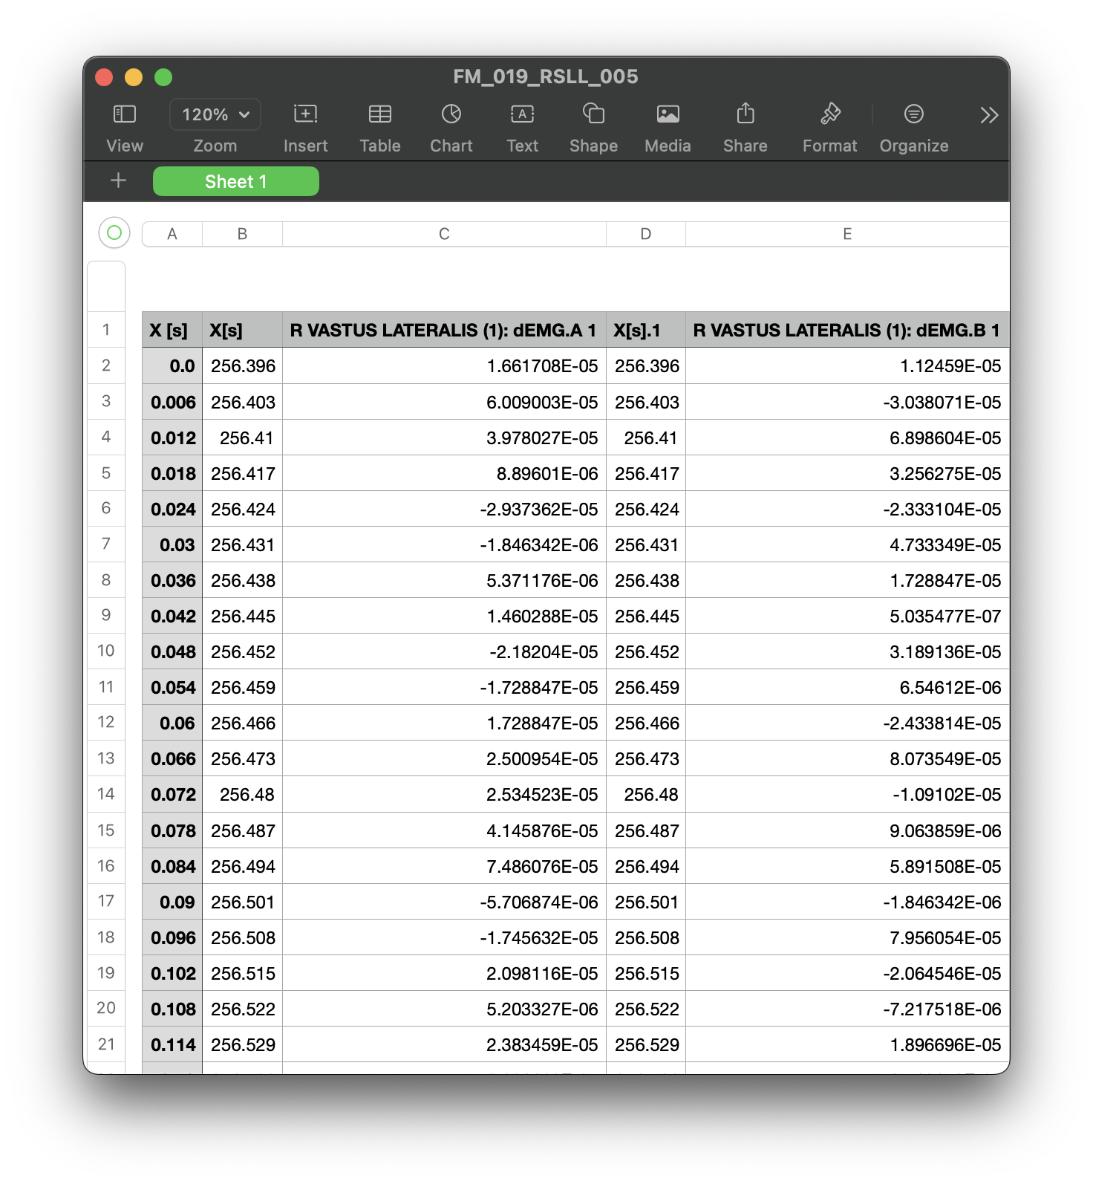
DEMOSTRATION
Python Script for Final Alignment

Slide 15
NEXT STEPS SHORT-TERM
Verify Alignment Accuracy
Visual Comparison in MATLAB
Refine Alignment if Needed
Prepare Data for Statistical Analysis
Document the Workflow

Slide 16
NEXT STEPS LONG-TERM
01
Feature Extraction
Extract measurable metrics (e.g., onset time, activation peak) for statistical analysis.
02
Data Analysis or Modeling
Use aligned data to explore predictive modeling or pattern recognition.
03
Clinical Relevance
With validation, this process could help support early detection tools for knee degeneration in a clinical or research setting.

Slide 17
Q&A

